Slide 1
Review: Flow of Costs – Perpetual System
Maintains detailed records of the cost of each inventory purchase and sale.
Records continuously show inventory that should be on hand for every item.
Company determines cost of goods sold each time a sale occurs.
L O 1

Slide 2
Inventory Flow (Perpetual System) & How to Record
Beginning Inventory = 0
Bought 50 units at $10/unit
Sold 30 units at $20 /unit
Ending Inventory: 200 (20 units at $10/unit) → Next period’s beg. inv.
Inventory 500
Accounts Payable 500
Accounts Receivable 600
Sales Revenue 600
Cost of Goods Sold 300
Inventory 300

Slide 3
Entries to Record purchase of inventory (Perpetual System)
Inventory XXX
Accounts Payable XXX
L O 2

Slide 4
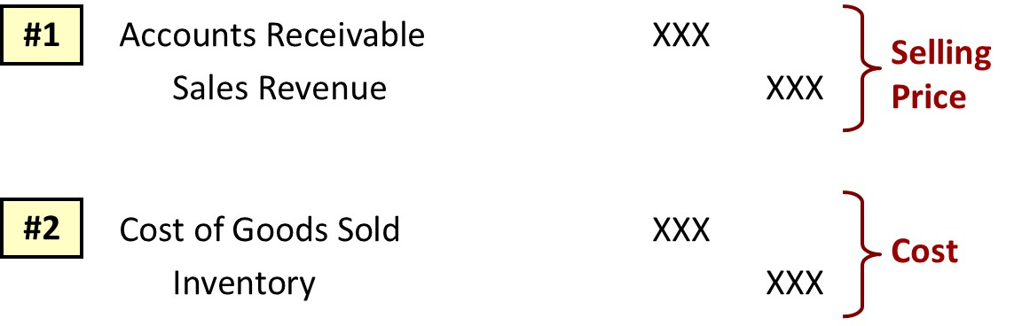
Entries to Record Sales (Perpetual System)
Journal Entries to Record a Sale
L O 3

Slide 5
Review: Flow of Costs (Perpetual System)
Purchase
Freight-in
Purchase return
Purchase discount
Sell inventory to customers
Sales return
Sales discount
L O 1

Slide 6
Purchases (Buyer)
Purchase
Delivery (FOB shipping point)
Buyer pays freight
Recorded as increase in inventory
Purchase return & allowance
Payment (purchase discount)
Inventory 1000
Accounts Payable 1000
Inventory (freight-in cost) 150
Cash 150
Accounts Payable 200
Inventory 200
Accounts Payable 800
Inventory 20
Cash 780
Notes:
Purchase discount → assume discount of $20
Crediting Inventory directly reduces the cost of the Inventory on hand, reflecting the fact that the company effectively paid less for the goods.
Reduce inventory cost due to discount.
Alternatively, we can also credit "Purchase Discounts" to track such discounts, which later impacts the cost of goods sold when inventory is sold.

Slide 7
Sales
Sales
Buy at $10/unit,
Sell 50 units at $20/unit
Delivery (FOB destination)
Seller pays
Part of operating exp for seller
Sales Return
AR 1000
Sales Rev 1000
COGS 500
Inventory 500
Freight Out 150
Cash 150
Sales Return 200
Accounts Receivable 200
Inventory 200
COGS 200

Slide 8
Sales
Discount
Cash 750
Sales Discount 50
Accounts Receivable 800

Slide 9
Record Purchases and Sales Under a Periodic Inventory System.
L O 7

Slide 10
Perpetual vs Periodic
Companies use either a perpetual inventory system or a periodic inventory system
Perpetual System
Maintain detailed records of the cost of each inventory purchase and sale
Records continuously to show inventory that should be on hand for every item, i.e., directly adjust the inventory account for any transaction that affects inventory (e.g., freight-in, returns, and discounts)
Company determines cost of goods sold each time a sale occurs
Periodic System
Does not keep detailed records of goods on hand
Still maintain records of each inventory purchase, but Costs of goods sold determined by count at the period end
Create different accounts for purchases, freight costs, returns, discounts.

Slide 11
Determining Cost Under Periodic Systems
No running account of changes in inventory.
Ending inventory determined by physical count.
Cost of goods sold not determined until the end of the period.
Cost of goods sold by subtracting ending inventory from the cost of goods available for sale.
+ | Beginning Inventory Cost of Goods Purchased
− | Cost of Goods Available for Sale Ending Inventory
 | Cost of Goods Sold
Illustration 5B.1: Basic formula for cost of goods sold using the periodic system
L O 7

Slide 12
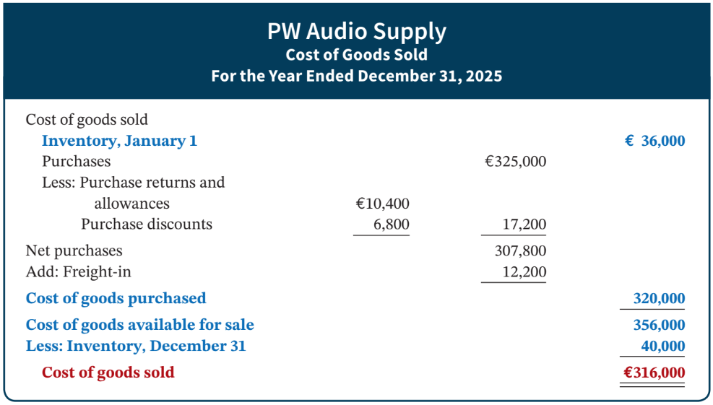
Cost of Goods Sold Example
Illustration 5B.2: Cost of goods sold for a merchandiser using a periodic inventory system
L O 7
Notes:
Read by self. Just shows how COGS appears in financial ststement

Slide 13
Recording Merchandise Transactions
Record revenues when sales are made.
Do not record cost of merchandise sold on date of sale.
Physical inventory count determines:
Cost of merchandise on hand and
Cost of merchandise sold during the period
Record purchases in Purchases account (rather than the inventory account). Purchase account is a temporary asset account.
Purchase returns and allowances, purchase discounts, and freight costs are recorded in separate accounts.
L O 7

Slide 14
Recording Purchase of Merchandise
Illustration: On the basis of the sales invoice and receipt of the merchandise ordered from PW Audio Supply, Sauk Stereo (buyer) records the €3,800 purchase as follows.
May 4
Purchases 3,800
Accounts Payable 3,800
Purchases is temporary account with normal debit balance
L O 7

Slide 15
Freight Costs Example (Periodic)
Illustration: If Sauk (buyer) pays Acme Freight Company €150 for freight charges on its purchase from PW Audio Supply on May 6, the entry on Sauk’s books is:
May 6
Freight-In (Transportation-In) 150
Cash 150
Freight-in is temporary account with normal debit balance
L O 7

Slide 16
Purchase Return Example (Periodic)
Illustration: Sauk Stereo returns €300 of goods to PW Audio Supply and prepares the following entry to recognize the return.
May 8
Accounts Payable 300
Purchase Returns and Allowances 300
Purchase returns and allowances is temporary account with normal credit balance
L O 7

Slide 17
Purchase Discount Example (Periodic)
Illustration: On May 14 Sauk Stereo pays the balance due on account to PW Audio Supply, taking the 2% cash discount allowed by PW Audio for payment within 10 days. Sauk Stereo records the payment and discount as follows.
May 14
Accounts Payable (€3,800 – €300) 3,500
Purchase Discounts (€3,500 × .02) 70
Cash 3,430
Purchase discounts is temporary account with normal credit balance
L O 7

Slide 18
Recording Sales of Merchandise (Periodic)
Illustration: PW Audio Supply (seller), records the sale of €3,800 of merchandise to Sauk Stereo on May 4 (sales invoice No. 731, slide 31) as follows.
May 4
Accounts Receivable 3,800
Sales Revenue 3,800
No entry is recorded for cost of goods sold at the time of the sale under a periodic system.
L O 7

Slide 19
Sales Returns and Allowances (Periodic)
Illustration: To record the returned goods received from Sauk Stereo on May 8, PW Audio Supply records the €300 sales return as follows.
May 8
Sales Returns and Allowances 300
Accounts Receivable 300
L O 7

Slide 20
Sales Discounts (Periodic)
Illustration: On May 14, PW Audio Supply receives payment of €3,430 on account from Sauk Stereo. PW Audio honors the 2% cash discount and records the payment of Sauk’s account receivable in full as follows.
May 14
Cash 3,430
Sales Discounts (€3,500 × .02) 70
Accounts Receivable (€3,800 – €300) 3,500
L O 7

Slide 21
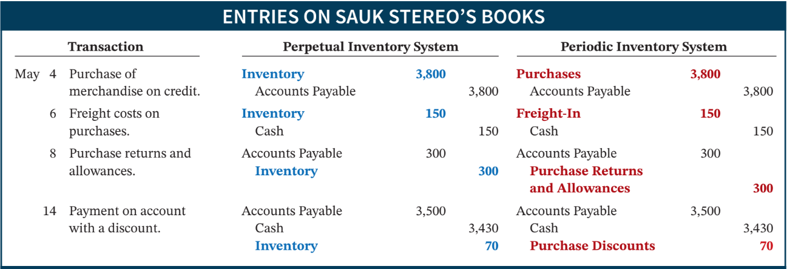
Comparison of Entries—Perpetual vs. Periodic (1 of 2)
Illustration 5B.3: Comparison of entries for perpetual and periodic inventory systems
L O 7

Slide 22
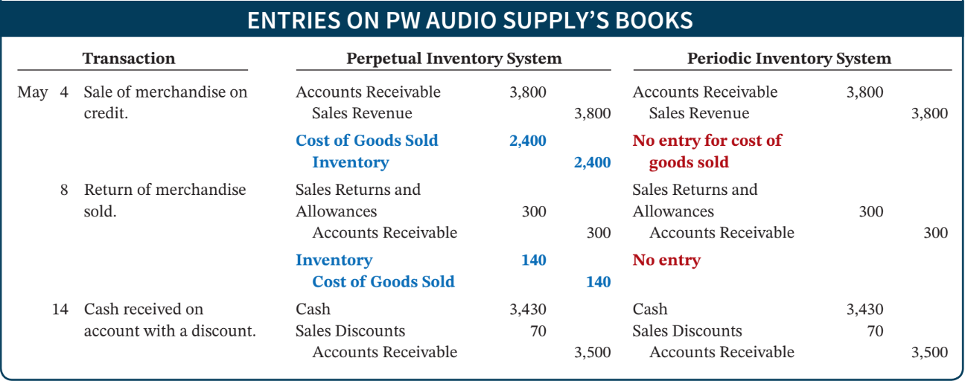
Comparison of Entries—Perpetual vs. Periodic (2 of 2)
Illustration 5B.3: Comparison of entries for perpetual and periodic inventory systems
L O 7

Slide 23
Financial Accounting
IFRS 5th Edition
Weygandt ● Kimmel
Chapter 6
Inventories
This slide deck contains animations. Please disable animations if they cause issues with your device.
Copyright © John Wiley & Sons, Inc.

Slide 24
Chapter Outline
Learning Objectives
LO 1 Discuss how to classify and determine inventory.
LO 2 Apply inventory cost flow methods and discuss their financial effects.
LO 3 Indicate the effects of inventory errors on the financial statements.
LO 4 Explain the statement presentation and analysis of inventory.

Slide 25
Learning Objective 1 Discuss How to Classify and Determine Inventory.
L O 1

Slide 26
Classifying Inventory
Merchandising Company
Manufacturing Company
One Classification:
Merchandise Inventory
Three Classifications:
Raw Materials
Work in Process
Finished Goods
Helpful Hint
Regardless of the classification, companies report all inventories under Current Assets on the statement of financial position.
L O 1
Notes:
Inventory: for companies sell good, before the goods are sold, those goods are called inventory

Slide 27
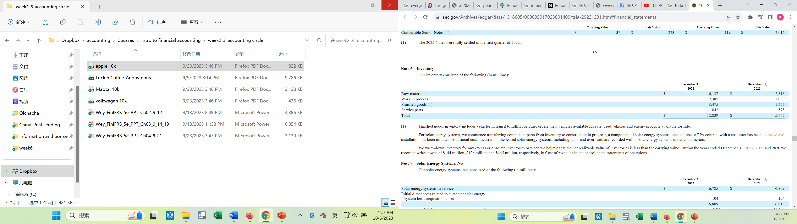
Sample Composition of Inventory Tesla
https://www.sec.gov/Archives/edgar/data/1318605/000095017023001409/tsla-20221231.htm#financial_statements
L O 1

Slide 28
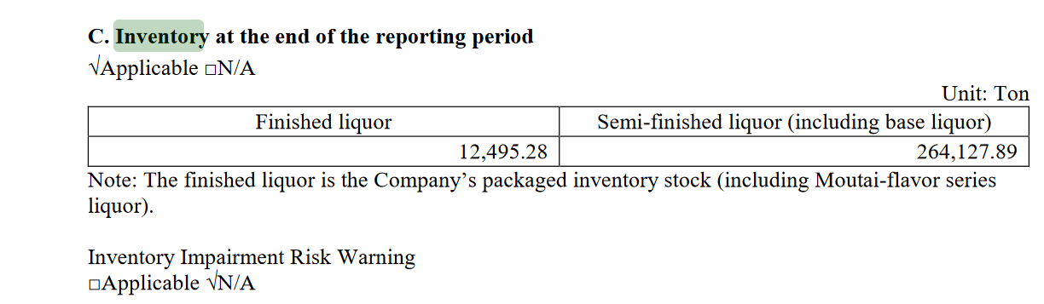
Sample Composition of Inventory Maotai
L O 1

Slide 29
Determining Inventory Quantities
Physical Inventory taken for two reasons:
Perpetual System
Check accuracy of inventory records.
Determine amount of inventory lost due to wasted raw materials, shoplifting, or employee theft.
Periodic System
Determine the inventory on hand.
Determine the cost of goods sold for the period.
L O 1

Slide 30
Taking a Physical Inventory
Involves counting, weighing, or measuring each kind of inventory on hand.
Taken usually at the end of the accounting period
L O 1

Slide 31
Determining Ownership of Goods
Goods In Transit
Purchased goods not yet received
Sold goods not yet delivered
Goods in transit should be included in the inventory of the company that has legal title to the goods.
Legal title is determined by the terms of sale.
L O 1

Slide 32
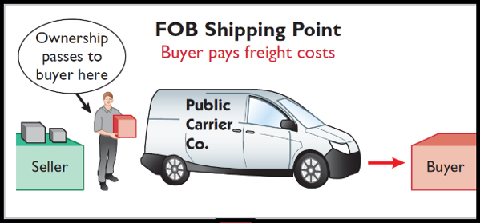
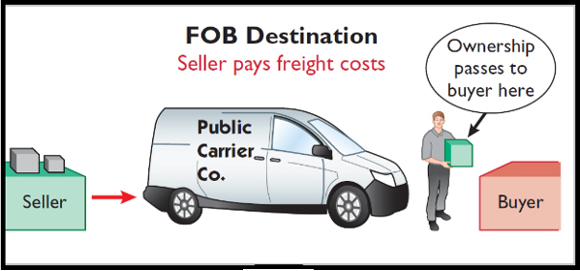
Freight Costs
Ownership of the goods passes to the buyer when the public carrier accepts the goods from the seller.
Ownership of the goods remains with the seller until the goods reach the buyer.
Illustration 6.2: Terms of sale
L O 1

Slide 33
Determining Ownership Review Question
Goods in transit should be included in the inventory of the buyer when the:
public carrier accepts the goods from the seller.
goods reach the buyer.
terms of sale are FOB destination.
terms of sale are FOB shipping point.
L O 1

Slide 34
Determining Ownership – Solution
Goods in transit should be included in the inventory of the buyer when the:
public carrier accepts the goods from the seller.
goods reach the buyer.
terms of sale are FOB destination.
terms of sale are FOB shipping point. (Correct)
L O 1

Slide 35
Determining Ownership – Consigned Goods (寄售货物）
To hold the goods of other parties and try to sell the goods for them for a fee, but without taking ownership of the goods.
Many car, boat, and antique dealers sell goods on consignment. Why?
Minimized Risks. The retailer then takes no risk in displaying the seller’s products
For sellers, the consigned retailer is basically doing free marketing for the product.
L O 1

Slide 36
DO IT! 1: Rules of Ownership
Deng Imports completed its inventory count. It arrived at a total inventory value of ¥200,000. You have been given the information listed below. Discuss how this information affects the reported cost of inventory.
Deng included in the inventory goods held on consignment for Falls Co., costing ¥15,000.
The company did not include in the count purchased goods of ¥10,000, which were in transit (terms: FOB shipping point).
The company did not include in the count inventory that had been sold with a cost of ¥12,000, which was in transit (terms: FOB shipping point).
L O 1

Slide 37
DO IT! 1: Rules of Ownership – Solution
Goods of ¥15,000 held on consignment should be deducted from the inventory count.
The goods of ¥10,000 purchased FOB shipping point should be added to the inventory count.
Item 3 was treated correctly.
Inventory should be ¥195,000 (¥200,000 − ¥15,000 + ¥10,000)
L O 1

Slide 38
Learning Objective 2 Apply Inventory Cost Flow Methods and Discuss Their Financial Effects.
L O 2

Slide 39
Inventory Methods and Financial Effects
Inventory is accounted for at cost.
Cost includes all expenditures necessary to acquire goods and place them in a condition ready for sale
Unit costs are applied to quantities to determine the total cost of inventory and cost of goods sold using the following costing methods:
Specific identification
Cost flow assumptions (First-in first-out and Average-cost)
L O 2

Slide 40
Specific Identification
Illustration: Crivitz TV Company purchases three identical 50-inch TVs on different dates at costs of £720, £750, and £800. During the year, Crivitz sold two sets at £1,200 each. These facts are summarized below.
Purchases
February 3 | 1 TV | at | £720
March 5 | 1 TV | at | £750
May 22 | 1 TV | at | £800
Sales
June 1 | 2 TVs | for | £2,400 (£1,200 × 2)
Illustration 6.3: Data for inventory costing example
L O 2

Slide 41
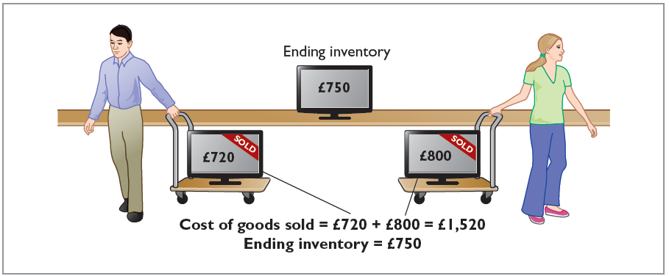
Specific Identification Illustrated
If Crivitz sold the TVs it purchased on February 3 and May 22, then its cost of goods sold is £1,520 (£720 + £800), and its ending inventory is £750.
Illustration 6.4: Specific identification method
L O 2

Slide 42
Specific Identification Costing
Costing method in which items still in inventory are specifically costed to arrive at the total cost of the ending inventory.
Practice is relatively rare, because there are few purchased products with unique identification codes that are clearly recorded in a company's accounting records
Most companies make assumptions (cost flow assumptions) about which units were sold
L O 2

Slide 43
Cost Flow Assumptions
There are two assumed cost flow methods:
First-in, first-out (FIFO)
Average-cost
Cost flow does not need be consistent with the physical movement of the goods.
L O 2

Slide 44
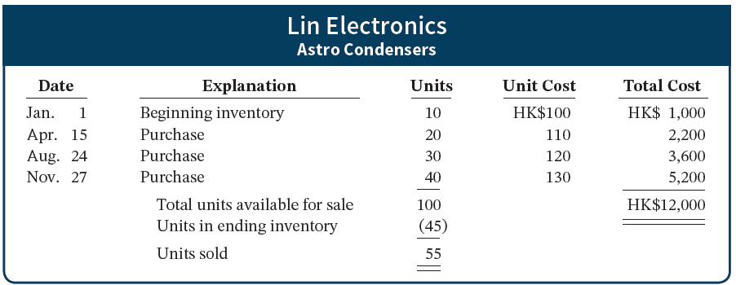
Cost Flow Assumptions – Example Data
Illustration 6.5: Data for Lin Electronics
L O 2
Notes:
We see that 45 units are in the ending inventory (by physical count). This will tell us that 55 units were sold.

Slide 45
First-In, First-Out (FIFO)
Costs of earliest goods purchased are first to be recognized in determining cost of goods sold.
Often parallels actual physical flow of merchandise.
Companies determine cost of ending inventory by taking the unit cost of the most recent purchase and working backward until all units of inventory have been costed.
L O 2

Slide 46
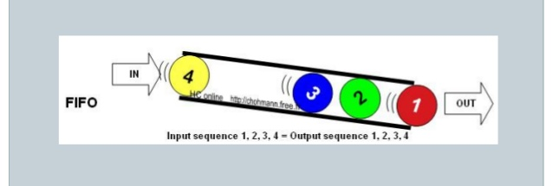
FIFO
First-in-first-out (FIFO) method

Slide 47
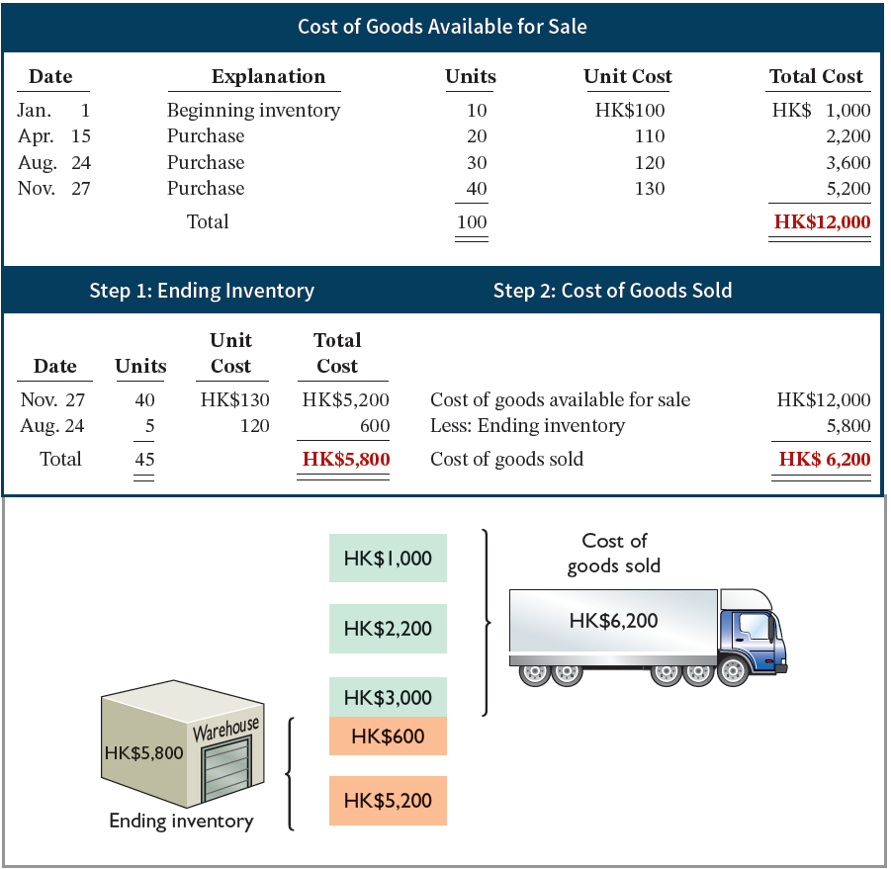
First-In, First-Out (FIFO) Allocation
Illustration 6.6: Allocation of costs – FIFO method
L O 2
Notes:
55 units sold; 45 units remain
Compute using ending inventory (40 * 130 + 5 * 120)
Compute using COGS, directly (10 * 100 + 20 * 110 + 25 * 120)

Slide 48
Average-Cost – Illustration 6.8
Allocates cost of goods available for sale on the basis of weighted-average unit cost incurred.
Applies weighted-average unit cost to units on hand to determine cost of ending inventory.
Assumes that goods are similar in nature.
Cost of Goods Available for Sale | ÷ | Total Units Available for Sale | = | Weighted-Average Unit Cost
HK$12,000 | ÷ | 100 | = | HK$120
Illustration 6.8: Formula for weighted-average unit cost
L O 2

Slide 49
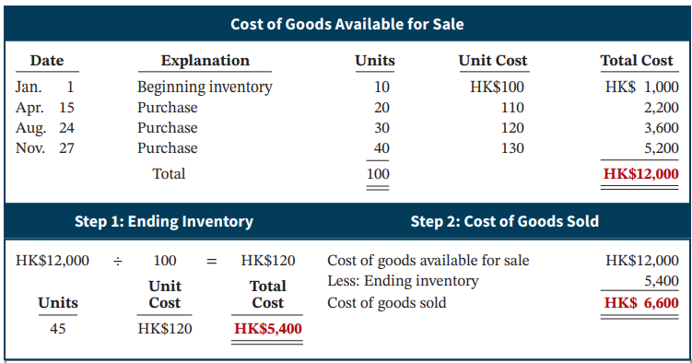
Average-Cost Allocation
Illustration 6.9: Allocation of costs─ average-cost method
L O 2

Slide 50
Financial Statement and Tax Effects of Cost Flow Methods
Either of the two cost flow assumptions is acceptable for use.
A recent survey of IFRS companies indicated that approximately 60% of these companies use the average-cost method, with 40% using FIFO.
Approximately 23% use both average-cost and FIFO for different parts of their inventory.
L O 2

Slide 51
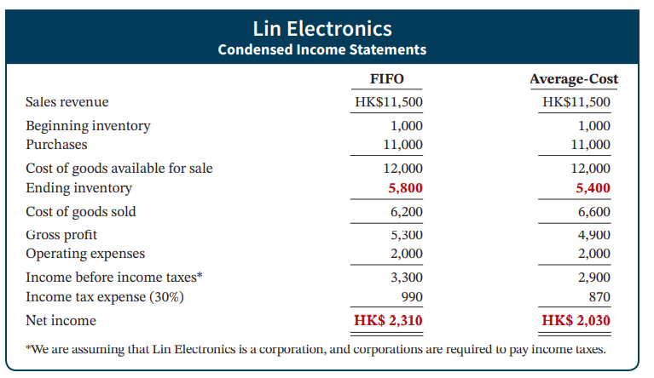
Income Statement Effects – Illustration 6.10
Illustration 6.10: Comparative effects of cost flow methods
L O 2

Slide 52
Statement of Financial Position Effects
A major advantage of the FIFO method is that in a period of inflation, costs allocated to ending inventory will approximate their current cost
A shortcoming of the average-cost method is that in a period of inflation, costs allocated to ending inventory may be understated in terms of current cost
L O 2

Slide 53
Tax Effects
Both inventory and net income are higher when companies use FIFO in a period of inflation
Average-cost results in lower income taxes (because of lower net income) during times of rising prices
The tax savings makes more cash available for use in the business
The tax effect will reverse in the next year i.e., average cost result lower taxes in year 1, but will result in higher taxes in year 2.
L O 2

Slide 54
Using Inventory Cost Flow Methods Consistently
The method chosen should be used consistently, enhancing comparability over time
Although consistency is preferred, a company may change its inventory costing method
Should disclose the change and its effect on net income
L O 2

Slide 55
Cost Flow Assumptions Review Question
The cost flow method that often parallels the actual physical flow of merchandise is the:
FIFO method
LIFO method
average cost method
gross profit method
L O 2

Slide 56
Cost Flow Assumptions – Solution
The cost flow method that often parallels the actual physical flow of merchandise is the:
FIFO method (Correct)
LIFO method
average cost method
gross profit method
L O 2

Slide 57
DO IT! 2: Cost Flow Methods
The accounting records of Shumway Implements show the following data.
Beginning inventory | 4,000 units at € 3
Purchases | 6,000 units at € 4
Sales | 7,000 units at €12
Determine the cost of goods sold during the period under a periodic inventory system using (a) the FIFO method, and (b) the average-cost method.
L O 2

Slide 58
DO IT! 2: Cost Flow Methods – Solution
Cost of goods available for sale = (4,000 × €3) + (6,000 × €4) = €36,000
Ending inventory = 10,000 − 7,000 = 3,000 units
FIFO: €36,000 − (3,000 × €4) = €24,000 or 4000*3+3000*4=24,000
Average cost per unit: [(4,000 @ €3) + (6,000 @ €4)] ÷ 10,000 = €3.60
Average-cost: €36,000 − (3,000 × €3.60) = €25,200 or 7000*3.6=25,200
L O 2

Slide 59
Learning Objective 3 Indicate the Effects of Inventory Errors on the Financial Statements.
L O 3

Slide 60
Effects of Inventory Errors
Common Causes:
Failure to count or price inventory correctly
Not properly recognizing the transfer of legal title to goods in transit
Errors affect both the income statement and the statement of financial position
L O 3

Slide 61
Income Statement Effects
Inventory errors affect the computation of cost of goods sold and net income in two periods.
Beginning Inventory | + | Cost of Goods Purchased | − | Ending Inventory | = | Cost of Goods Sold
Illustration 6.11: Formula for cost of goods sold
When Inventory Error: | Cost of Goods Sold Is: | Net Income Is:
Understates beginning inventory | Understated | Overstated
Overstates beginning inventory | Overstated | Understated
Understates ending inventory | Overstated | Understated
Overstates ending inventory | Understated | Overstated
Illustration 6.12: Effects of inventory errors on current year’s income statement
L O 3

Slide 62
Income Statement Effect on Two Periods
Inventory errors affect the computation of cost of goods sold and net income in two periods.
An error in ending inventory of current period will have a reverse effect on net income of next accounting period
Over two years, total net income is correct because errors offset each other
The correctness of the ending inventory depends entirely on the accuracy of taking and costing the inventory
L O 3

Slide 63
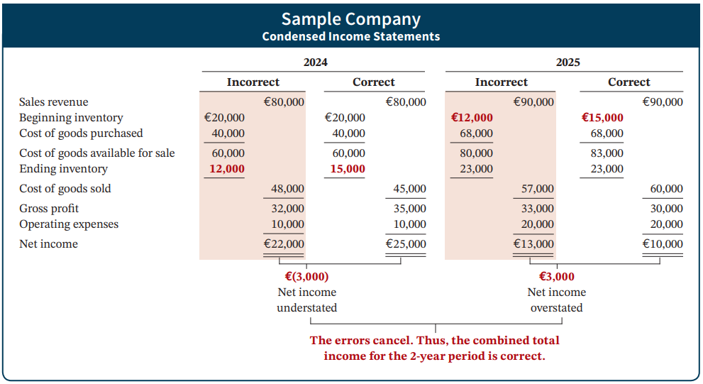
Income Statement Effects Illustrated
Illustration 6.13: Effects of inventory errors on two years’ income statements
L O 3

Slide 64
Learning Objective 4 Explain the Statement Presentation and Analysis of Inventory.
L O 4

Slide 65
Presentation
Statement of Financial Position - Inventory classified as current asset.
Income Statement - Cost of goods sold subtracted from net sales.
There also should be disclosure of
major inventory classifications
basis of accounting (cost or lower of cost or net realizable value))
cost method (FIFO, or average-cost)
L O 4

Slide 66
Tesla inventory note
Inventory Valuation
Inventories are stated at the lower of cost or net realizable value. Cost is computed using standard cost for vehicles and energy products, which approximates actual cost on a first-in, first-out basis. We record inventory write-downs for excess or obsolete inventories based upon assumptions about current and future demand forecasts. If our inventory on-hand is in excess of our future demand forecast, the excess amounts are written-off.
We also review our inventory to determine whether its carrying value exceeds the net amount realizable upon the ultimate sale of the inventory. This requires us to determine the estimated selling price of our vehicles less the estimated cost to convert the inventory on-hand into a finished product. Once inventory is written-down, a new, lower cost basis for that inventory is established and subsequent changes in facts and circumstances do not result in the restoration or increase in that newly established cost basis.
Should our estimates of future selling prices or production costs change, additional and potentially material write-downs may be required. A small change in our estimates may result in a material charge to our reported financial results.
https://www.sec.gov/Archives/edgar/data/1318605/000095017023001409/tsla-20221231.htm#financial_statements
Pg.35

Slide 67
Lower-of-Cost-or-Net Realizable Value
When the value of inventory is lower than its cost:
Companies must “write down” inventory to its net realizable value
Net realizable value: Amount that company expects to realize (receive) from the sale of inventory
Example of prudence (conservatism)
L O 4

Slide 68
LCNRV Example
Illustration: Assume that Gao TVs has the following lines of merchandise with costs and net realizable values as indicated.
 | Units | Cost per Unit | Net Realizable Value per Unit | Lower of Cost or Net Realizable Value
Flat-screen TVs | 100 | NT$600 | NT$550 | NT$ 55,000 (NT$550 × 100)
Wireless speakers | 500 | 90 | 104 | 45,000 (NT$90 × 500)
Bluetooth headphones | 850 | 50 | 48 | 40,800 (NT$48 × 850)
Smart watch accessories | 3,000 | 5 | 6 | 15,000 (NT$5 × 3,000)
Total inventory |  |  |  | NT$ 155,800
Illustration 6.15: Computation of lower of cost or net realizable value
L O 4

Slide 69
The implications of inventory write down
Think about the real estate, where the inventory of the real estate companies are property under construction or property for sale
Under a real estate crisis, when the property value goes down, what would happen?
https://vanke.com/upload/file/2023-03-31/89e1d820-c90c-4025-8368-55111c42eef1.pdf

Slide 70

Vanke’s inventory
https://www1.hkexnews.hk/listedco/listconews/sehk/2022/0421/2022042100475.pdf

Slide 71


Slide 72


Slide 73
Analysis Measures
Inventory turnover measures the number of times on average the inventory is sold during the period.
Cost of Goods Sold
Inventory Turnover =
Average Inventory
Days in inventory measures the average number of days inventory is held.
Days in Year (365)
Days in Inventory =
Inventory Turnover
L O 4

Slide 74
Analysis Example
Illustration: Esprit Holdings (HKG) reported in a recent annual report a beginning inventory of HK$3,209 million, an ending inventory of HK$3,254 million, and cost of goods sold for the year ended of HK$12,071 million. The illustration shows the inventory turnover formula and computation for Esprit Holdings.
Cost of Goods Sold | ÷ | Average Inventory | = | Inventory Turnover
HK$12,071 | ÷ |  | = | 3.7 times
Illustration 6.16: Inventory turnover formula and computation for Esprit Holdings (in millions)
L O 4

Slide 75
Inventory turnover for major companies
Walmart: about 8.2 as of 2023
JD.com: about 14 as of 2023
Apple: about 33.97 as of 2023
Xiaomi: about 4.5 as of 2023
L O 4

Slide 76
Financial Analysis and Data Analytics
Inventory management is a double-edged sword
High Inventory Levels – may incur high carrying costs (e.g., investment, storage, insurance, obsolescence, and damage)
Low Inventory Levels – may lead to stock-outs and lost sales
L O 4

Slide 77
Data Analytics
Companies can use data analytics to improve inventory management.
Example: Walmart (USA) collects data about every inventory item and customer. They use it to analyze customer habits, buying patterns and sales trends.
L O 4

